Slide 1



SIGNATURE VERIFICATION SYSTEM AND FRAUD DETECTION
Presented By,
MADHUVADHANI S (811722104085)
NITHIKA G (811722104104)
PREETHI S (811722104112)
Guided By,
Mrs. M.Mathumathi, M.E.,
DD/MM/YYYY

Slide 2
ABSTRACT
Development of an automated signature verification system using machine learning technique.
These systems leverage advanced techniques like machine learning ,neural networks and pattern recognition to provide a high level of accuracy and false acceptance
The system aims to authenticate individuals by comparing handwritten signatures to previously stored samples.
DD/MM/YYYY

Slide 3
OBJECTIVE
The primary objective of a signature verification system is to authenticate the identity of individuals by verifying their signatures against stored records
This system aims to detect and prevent fraudulent activities by distinguishing between genuine signatures and forgeries.
The verification process enhances security in various sectors such as banking , legal and administrative , ensuring that sensitive transactions are protected.
DD/MM/YYYY

Slide 4
LITERATURE SURVEY
S.No. | Paper Title | Year | Remark
1 | A Survey on Handwritten Signature Verification Techniques | 2011 | Comprehensive survey covering online and offline methods, focusing on challenges such as variability and forgery.
2 | A Novel Offline Signature Verification Method Based on Local Feature Extraction and Support Vector Machine" | 2007 | Introduced a method combining local feature extraction and SVM, improving resistance to forgery.
3 | Robustness of Offline Signature Verification Based on Gray Level Features" | 2012 | Utilized texture and contour features with SVM for reliable classification of signatures.
DD/MM/YYYY

Slide 5
LITERATURE SURVEY
S.No. | Paper Title | Year | Remark
4 | Online Signature Verification: Fusion of Real and Synthetic Samples for Training | 2015 | Proposed CNN-based model for enhanced training using real and synthetic signatures.
5 | Secure Offline Signature Verification Using Convolutional Neural Networks | 2016 | CNN-based approach offering better accuracy and reduced need for manual preprocessing.
6 | Hybrid Deep Learning Approach for Signature Verification | 2021 | Combined CNN and LSTM to handle both spatial and temporal dynamics of signatures.
DD/MM/YYYY

Slide 6
LITERATURE SURVEY
S.No. | Paper Title | Year | Remark
7 | On-line Signature Verification by Jain, Griess, and Connell | 2002 | Early influential work in online verification, widely cited for foundational methodologies.
8 | Reducing Forgeries in Writer Independent Off-line Signature Verification through Ensemble of Classifiers | 2010 | Focused on ensemble classifiers to boost verification accuracy and reduce false positives.
9 | Pattern Recognition for Handwritten Signatures | 2009 | Addresses basic pattern recognition techniques foundational to signature verification.
DD/MM/YYYY

Slide 7
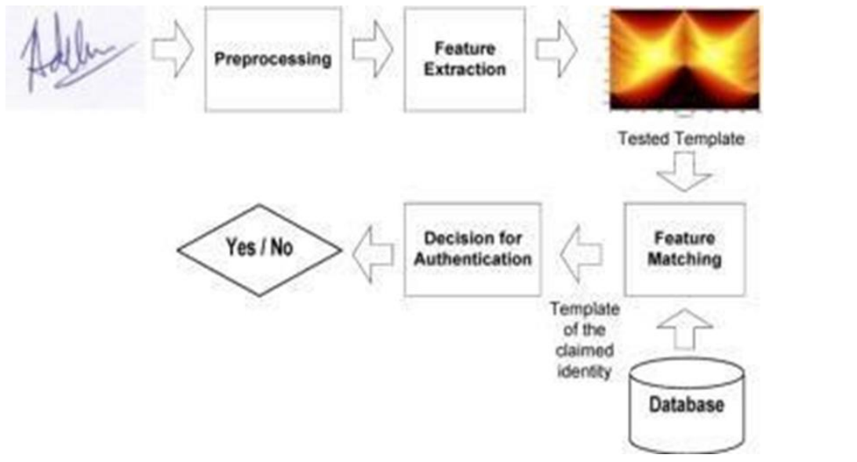
EXISTING SYSTEM
DD/MM/YYYY

Slide 8
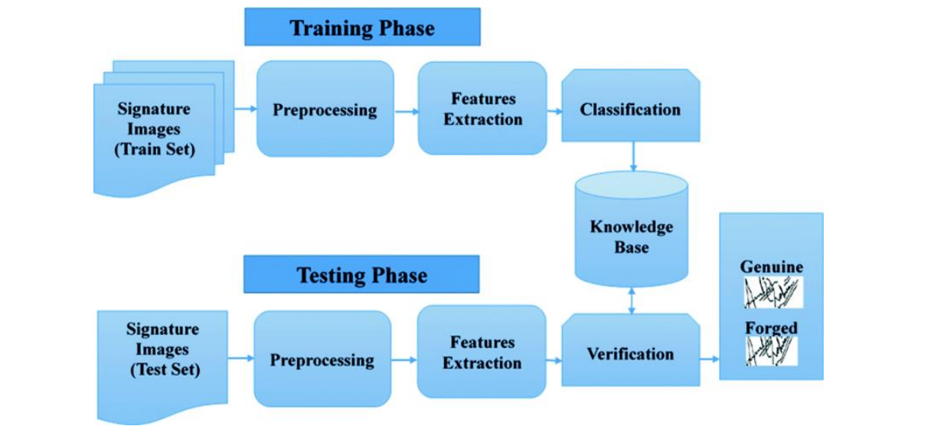
PROPOSED SYSTEM
DD/MM/YYYY

Slide 9
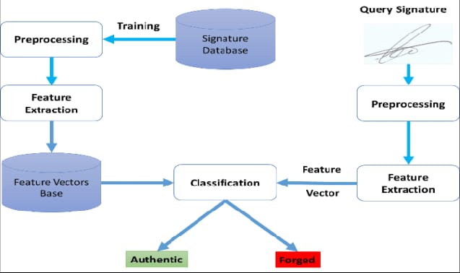
SYSTEM ARCHITECTURE
DD/MM/YYYY

Slide 10
MODULE 1 : User Interface
•Description: Interface for users (e.g., bank employees or customers) to upload and manage signatures.
• Features:
• Upload reference and test signature image
• View verification results
• Admin login for system access..
DD/MM/YYYY

Slide 11
MODULE 2 : Image Pre-Processing
•Description: Processes input signature images to normalize and enhance them
•Techniques:
• Grayscale conversion.
• Noise reduction (e.g., Gaussian blur).
• Thresholding (binarization).
• Resizing and alignment.
DD/MM/YYYY

Slide 12
MODULE 3 : Feature Extraction
• Description: Extracts important features from signatures for comparison.
• Techniques:
• Contour and edge detection (e.g., Canny).
• Histogram of Oriented Gradients (HOG).
• Fourier Descriptors or SIFT/SURF features.
DD/MM/YYYY

Slide 13
MODULE 4 : Signature Verification
• Description: Compares input signature with stored (genuine) ones
• Technique:
• Machine learning models (e.g., SVM, CNN, Siamese Network).
• Distance metrics (Euclidean, cosine similarity).
• Output: Match or mismatch decision with confidence score.
DD/MM/YYYY

Slide 14
MODULE 5 : Fraud Detection And Logging
• Description: Detects forged or suspicious signatures
• Techniques:
• Anomaly detection models.
• Behavioural analysis if using dynamic signature (e.g., speed,
pressure).
• Logs:
• Maintain records of failed verifications.
• Alert generation for potential fraud.
DD/MM/YYYY

Slide 15
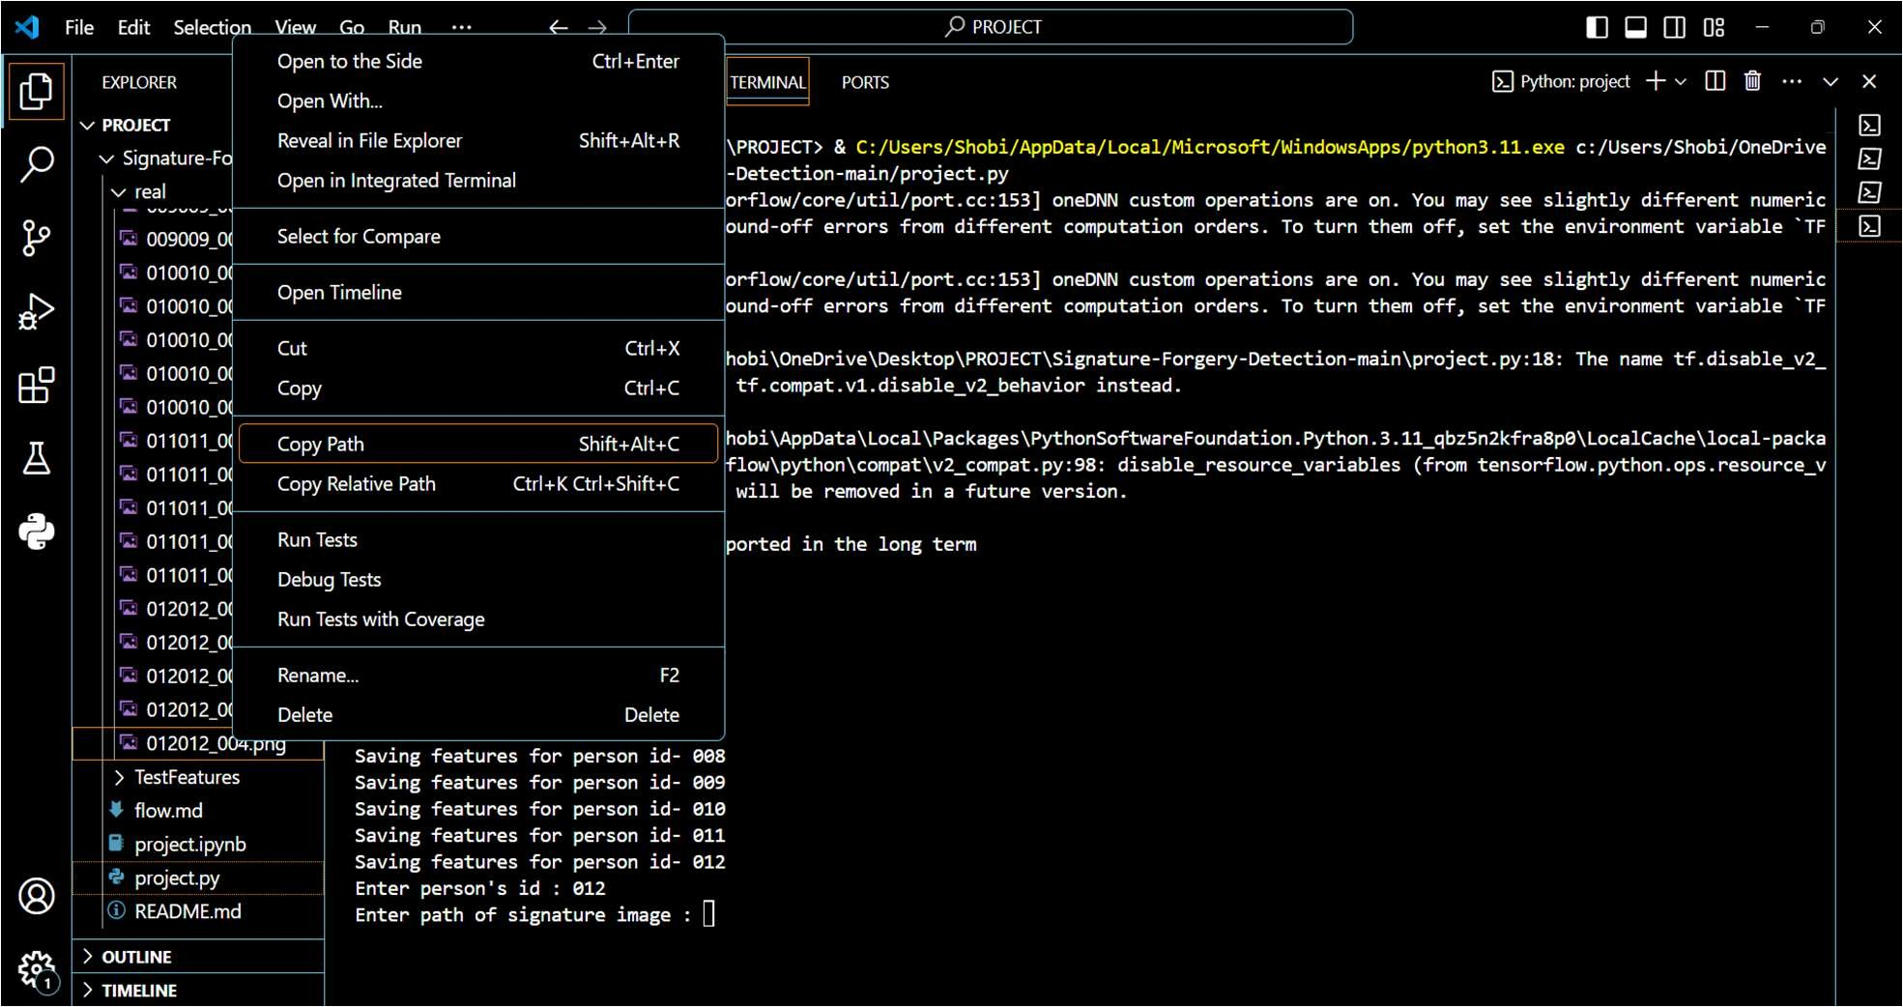
OUTPUT
DD/MM/YYYY

Slide 16
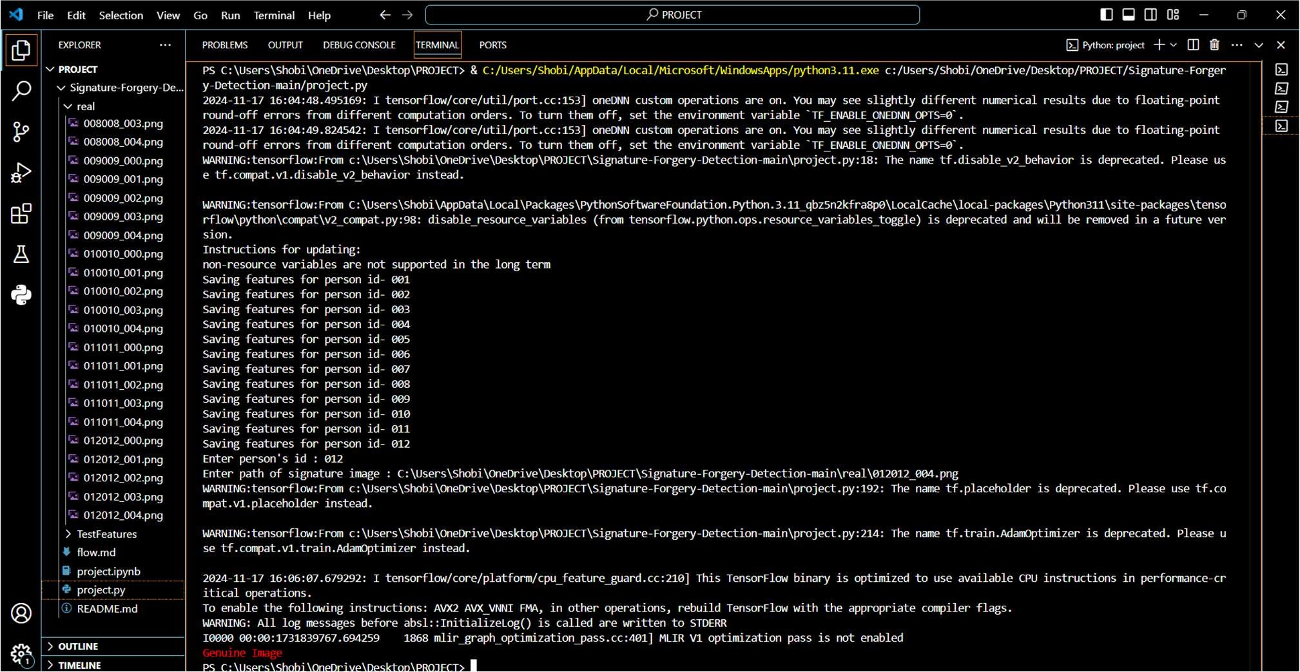
OUTPUT
DD/MM/YYYY

Slide 17
CONCLUSION & FUTURE ENHANCEMENT
Preprocessing: steps like grayscale conversion and noise reduction enhance image quality.
The project successfully implements a signature verification system using image processing and machine learning techniques.
Real-Time Verification: Enable real-time processing for use in mobile apps and online platforms.
Biometric Fusion: Combine signature verification with facial recognition or fingerprint authentication for enhanced security.
DD/MM/YYYY

Slide 18
REFERENCES
Sarkar, S., Majumdar, A. K., & Chaudhuri, S. (2011). A survey on handwritten signature verification techniques.
Li, M., & Wang, Y. (2007). A novel offline signature verification method based on local feature extraction and support vector machine.
Jain, A. K., Griess, F. D., & Connell, S. D. (2002). Online signature verification. Pattern Recognition, 35(12), 2963–2972.
DD/MM/YYYY

Slide 19

DD/MM/YYYY

